Slide 1
Worthless
Where do philosophy graduates end up?
MATTHEW WAKEHAM
DATA SOURCE: U.S. CENSUS BUREAU ACS 5-YEAR PUMS 2023
Notes:
Worthless?

Slide 2
Data Source
The Census Bureau provides public microdata samples accessible through an API based on the American Community Survey with the option of 1-year and 5-year datasets
  Identifiers allow you to select a specific dataset with other classification
  YEAR
  DATASET
  FOD_CODE
  Variables define what the columns represent
  PWGTP
  FOD1P
  FOD2P
  SCHL
  OCCP
  INDP
  WAGP
  PERNP
  ESR
  AGEP
  GENDER
Notes:
Examining the data source – API introduction, identifiers, variables, and more

Slide 3
Pipeline and Methodology
I built a complete pipeline
  PYTHON > API > S3 > SNOWFLAKE > POWER BI
Extract, transform, load
  Python grabs the dataset from an API with predefined parameters and drops it into S3
  Preliminary analysis, calculation to include weight, and views done in Snowflake
  Data ultimately loaded into Power Bi to perform further analysis and create dashboards
Notes:
Describe pipeline and analysis methodology

Slide 4
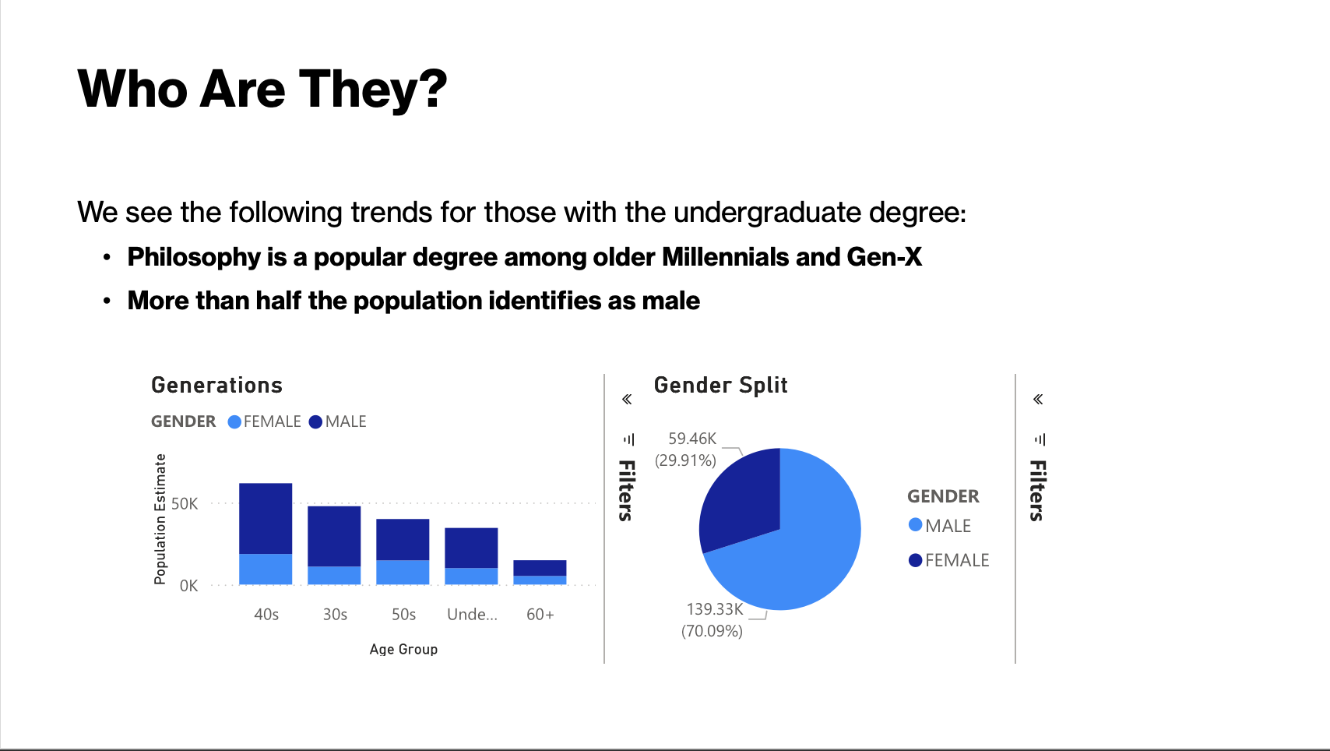

Slide 5
Who Are They? Cont.
198,785 people hold undergraduate philosophy degrees
And finally, the numbers you actually came here for:
Average Wage $102K
Median Wage $90K
Notes:
Population of BA degree holders, and average wage

Slide 6
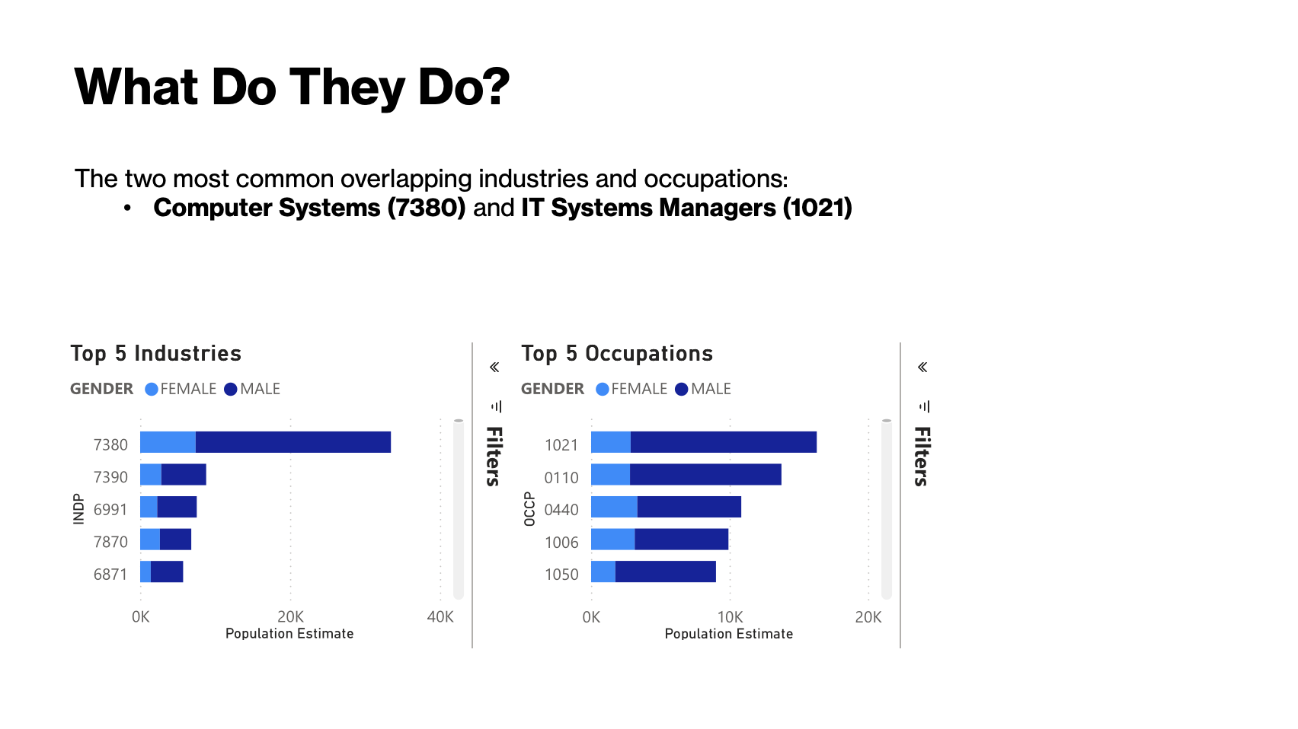

Slide 7
Does More Education Pay Off?
Education beyond the undergraduate level may pay off for some people
Areas where more education likely improves outcomes for philosophy majors:
Technology
Legal
Business
Education
Notes:
Areas where further education improves outcomes based on popular industries for philosophy majors

Slide 8
The High Ceiling
Advanced education greatly increases the potential to earn more
Based on the most common industries and occupations, professional degrees win
Finally, people identifying as philosophy majors and who pursued further education earn on average:
Average Wage $107K
Median Wage $94K
Notes:
Benefits of a professional or other degree

Slide 9
The Realistic Picture
  Choice of industry matters
    The degree gets your foot in the door like any other – the industry determines your pay
  First in, last out
    As a burgeoning industry, tech used to value analytical thinking over credentials
  Context of the student
    Location, university, and experience matter
Notes:
You must still choose an industry that pays well

Slide 10
So What?
Philosophy majors find themselves represented in some of the most popular, well-paying industries. What are the implications?
  It appears possible to have a good career with just the BA
  Those who pursue advanced education tend to do even better
  Academic departments can now recruit based on measurable outcomes
Notes:
Implications: departments can recruit on outcomes, law school path is validated, self-selection hypothesis worth studying, other

Slide 11
Some Limitations
FOD1P looks for philosophy majors first – FOD2P might include a second major which could positively affect outcomes
We can only infer what kind of advanced degree someone has by category and industry
Medians are not weighted, and while the average is more statistically significant due to being weighted, medians may be more intuitive for some people
The American Community Survey does not account for certifications
No comparison group

Slide 12
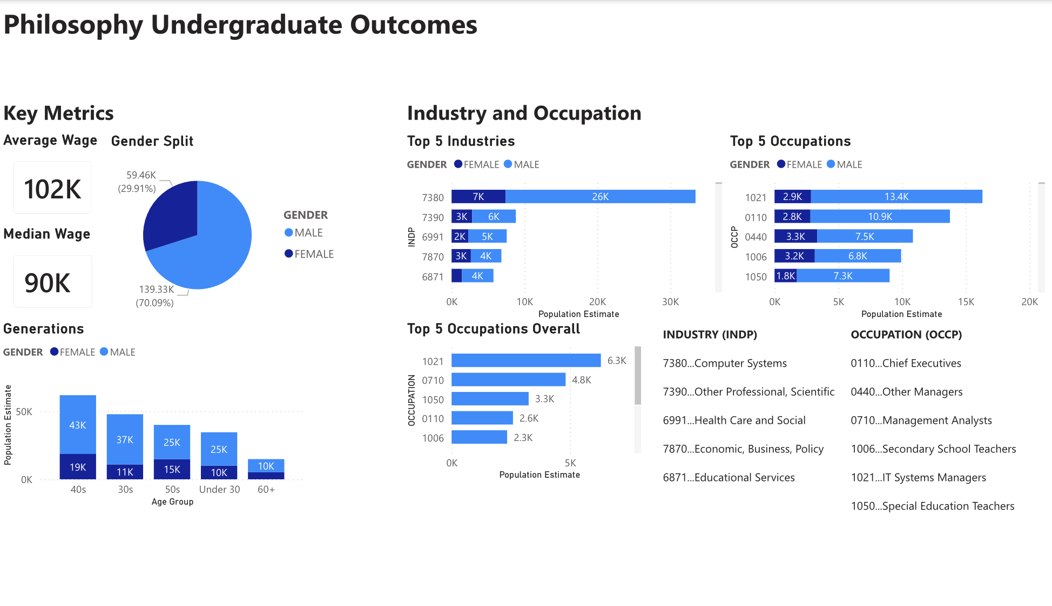

Slide 13
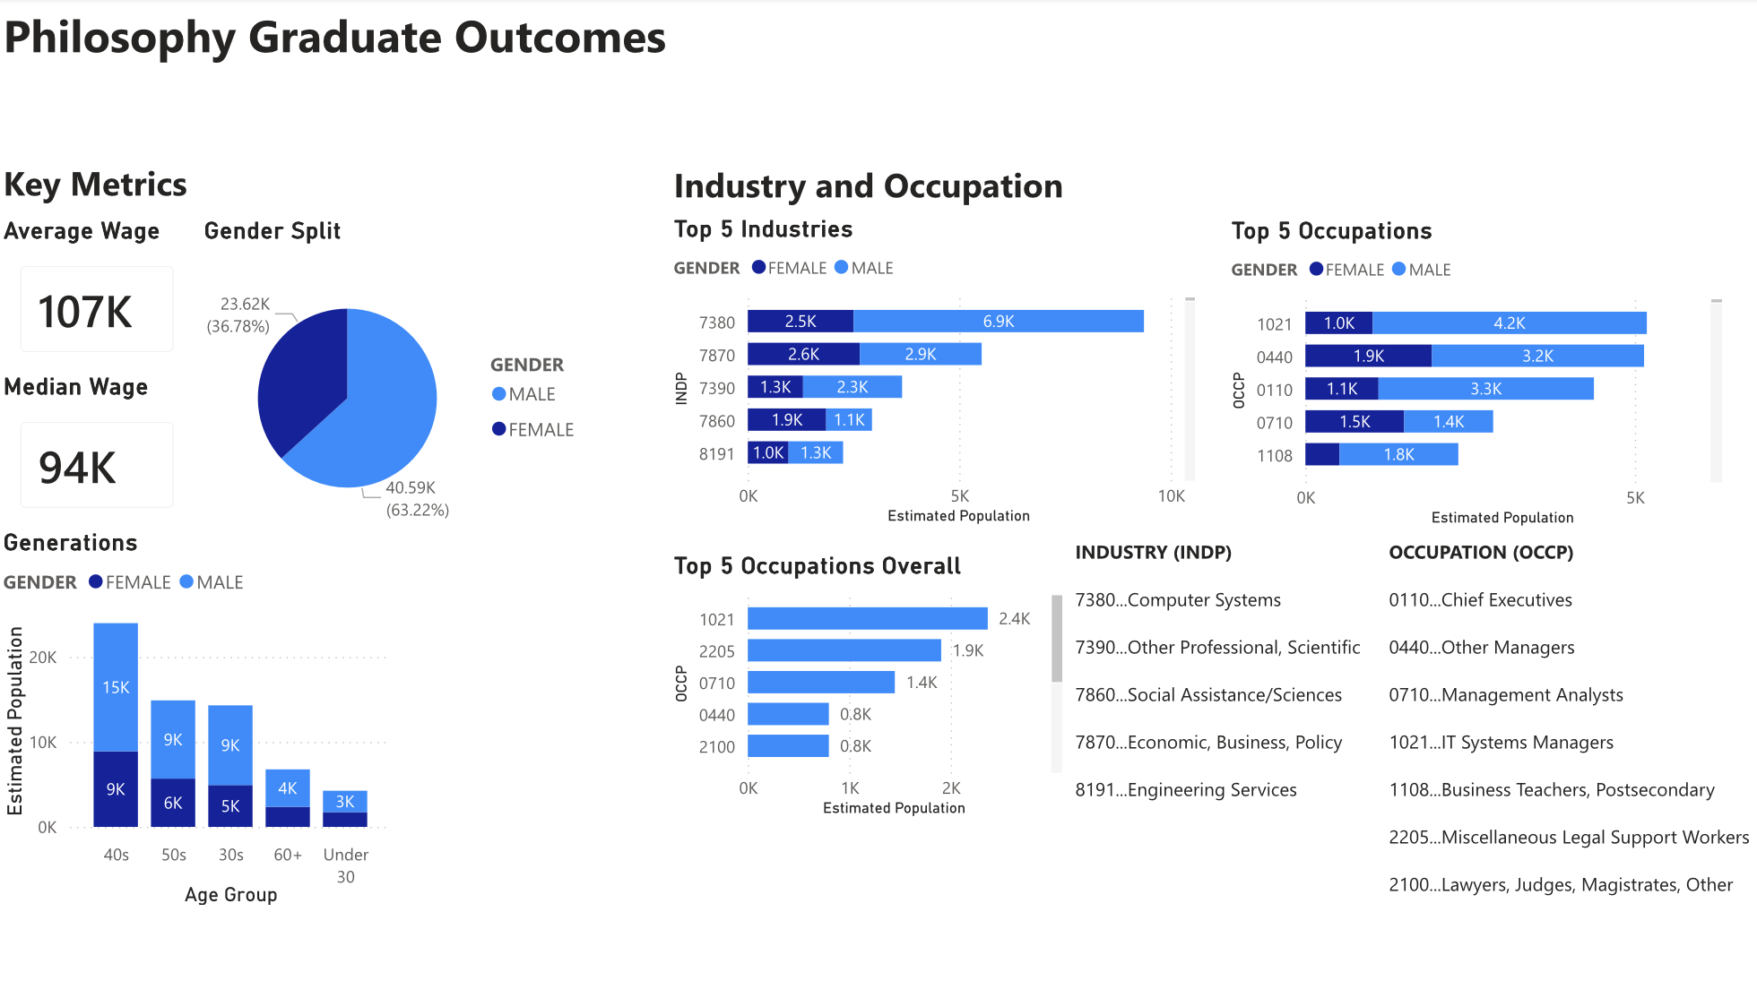

Slide 14
